Slide 1
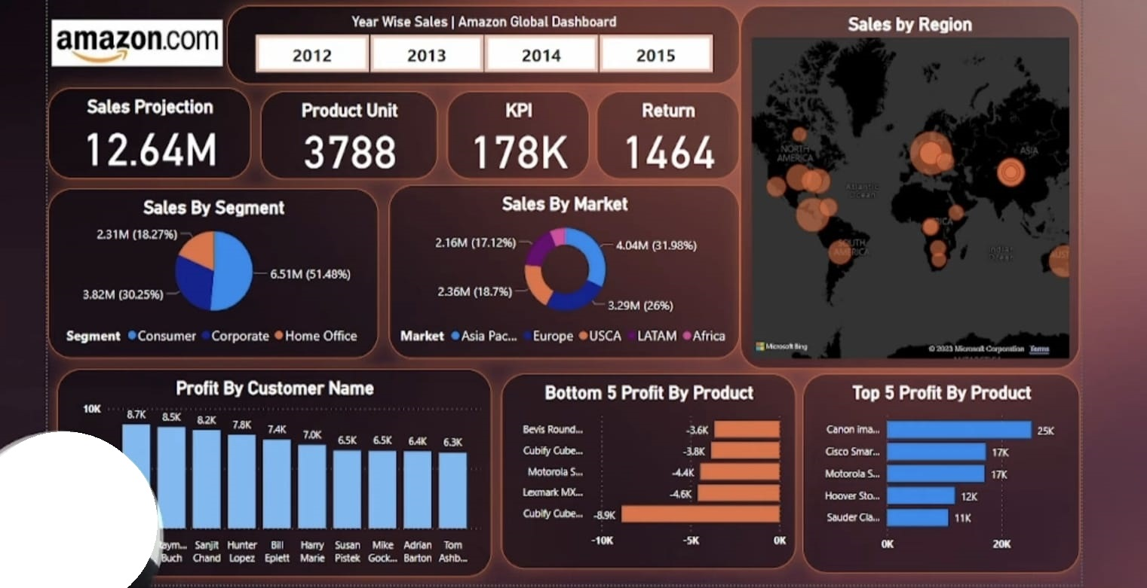
Amazon
Dashboard
Creation

